Slide 1

SECURITY BREACHES BASED ON SOFTWARE VULNERABILITIES
Denis Remus Marincaș (20099160)

Slide 2
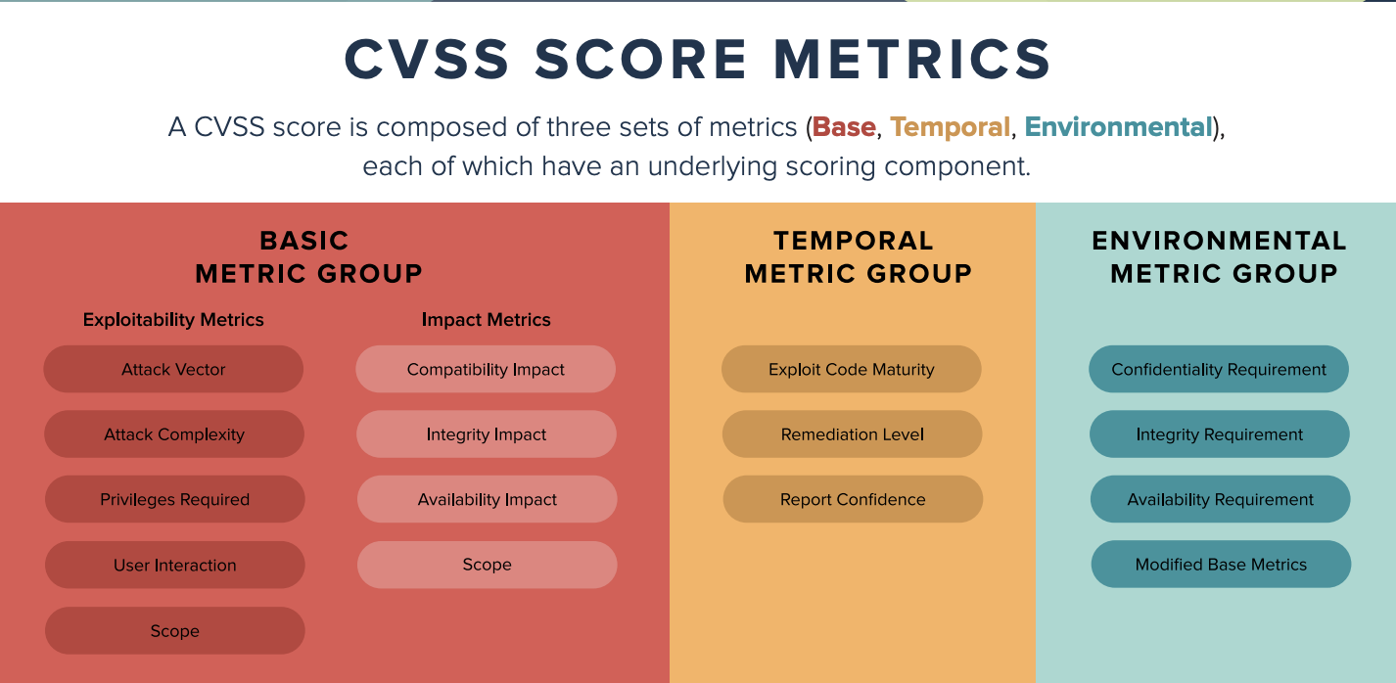
The Common Vulnerability Scoring System (CVSS)

Slide 3
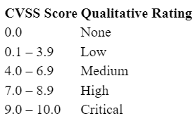
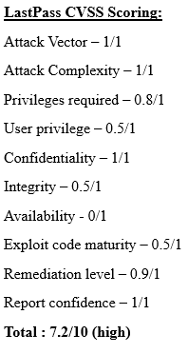
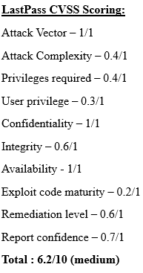
LastPass Attack
Colonial Pipeline Attack

Slide 4
Summary of attacks
LastPass
Password manager
Attackers gained access to the “customer vault”
One last line of defence
Employee credentials
Colonial Pipeline
Major gas and oil supplier on the east coast of the USA
Availability was hugely impacted
Ransomware attack
Employee credentials

Slide 5
LastPass
1st statement August 2022: unknown parties copied encrypted files that contained customers' stored passwords
2nd statement December 22nd : LastPass brings customers up to date, source code, storage volumes decrypted, emails, company names, phone numbers, IP addresses, attackers gained access to the “customer vault”
Attacker can now target individuals with phishing scams or brute-force attacks knowing their emails and IP addresses

Slide 6
LastPass
All user passwords are still encrypted thanks to the user master password
Passwords are encrypted with “256-bit AES encryption and can only be decrypted with a unique encryption key derived from each user’s master password”.

